Slide 1
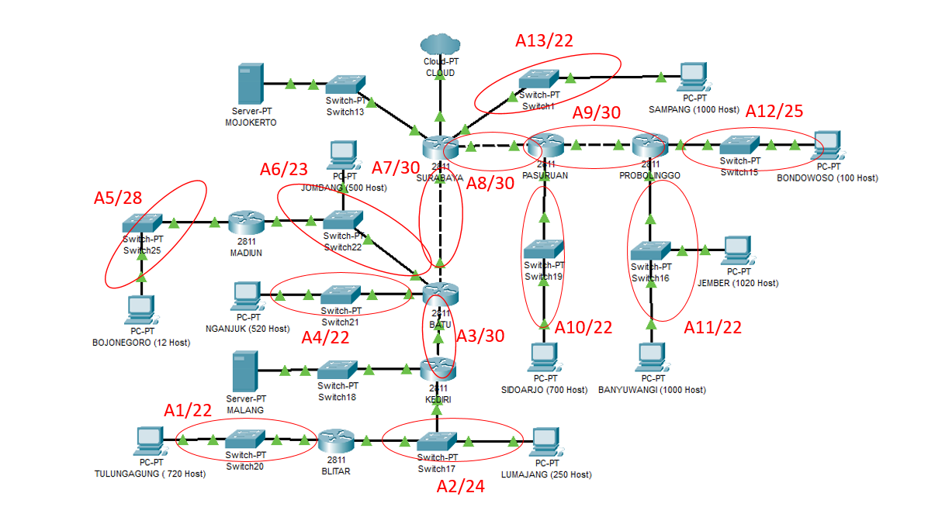
B2/22
B3/21
B1/21

Slide 2
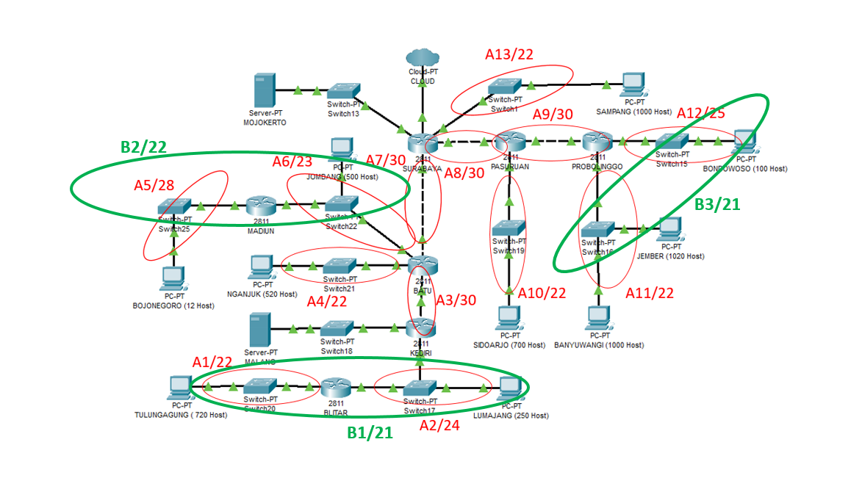
C2/21
C3/20
C1/20

Slide 3
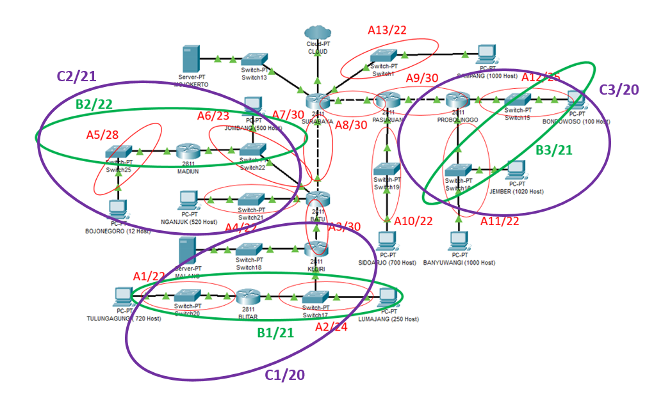
D2/19
D1/19

Slide 4
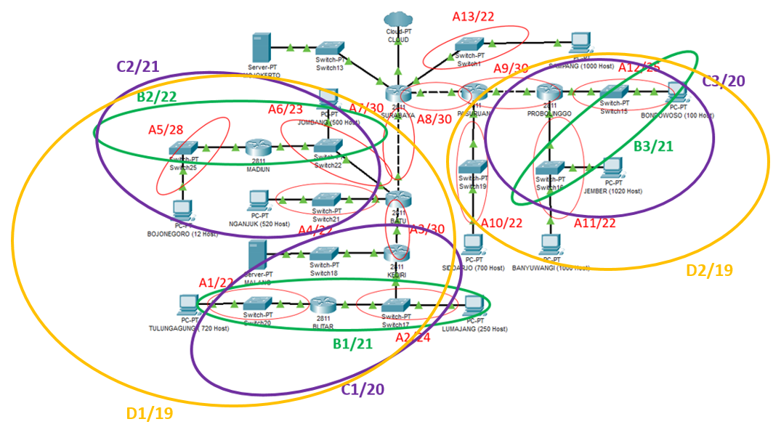
E1/18
E2/18

Slide 5
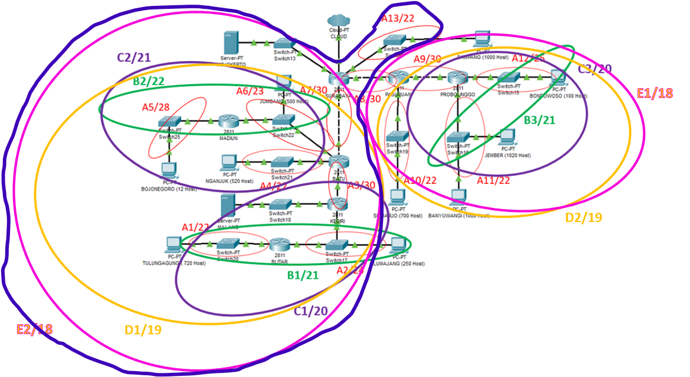
F1/17

Slide 6
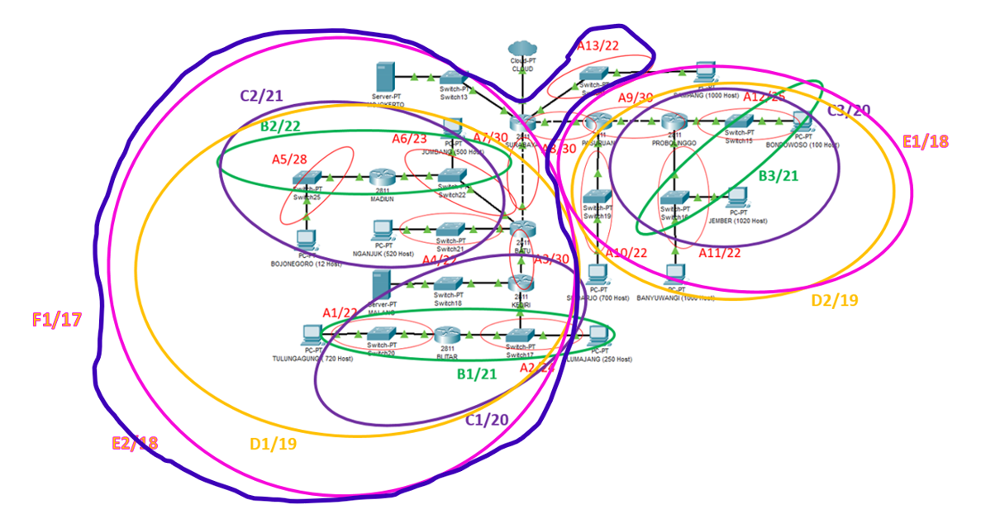
G1/16

Slide 7
NID: 192.168.0.0
Netmask: 255.255.0.0
Netmask /16
G1/16
192.168.0.0 / 16
F1/17
E1/18
192.168.0.0 / 17
192.168.128.0 / 18
A13/22
E2/18
A8/30
D2/19
192.168.64.0 / 22
192.168.0.0 / 18
192.168.160.0 / 30
192.168.128.0 / 19
D1/19
A7/30
C3/20
A10/22
192.168.0.0 / 19
192.168.32.0 / 30
192.168.128.0 / 20
192.168.144.0 / 22
C2/21
B3/21
A9/30
C1/20
192.168.128.0 / 21
192.168.136.0 / 30
192.168.0.0 / 20
192.168.16.0 / 21
A11/22
A12/25
192.168.128.0 / 22
192.168.132.0 / 25
A3/30
B1/21
192.168.8.0 / 30
192.168.0.0 / 21
B2/22
A4/22
192.168.16.0 / 22
192.168.20.0 / 22
A1/22
A2/24
A5/28
A6/23
192.168.0.0 / 22
192.168.4.0 / 24
192.168.16.0 / 28
192.168.18.0 / 23

Slide 8
REVISI

Slide 9
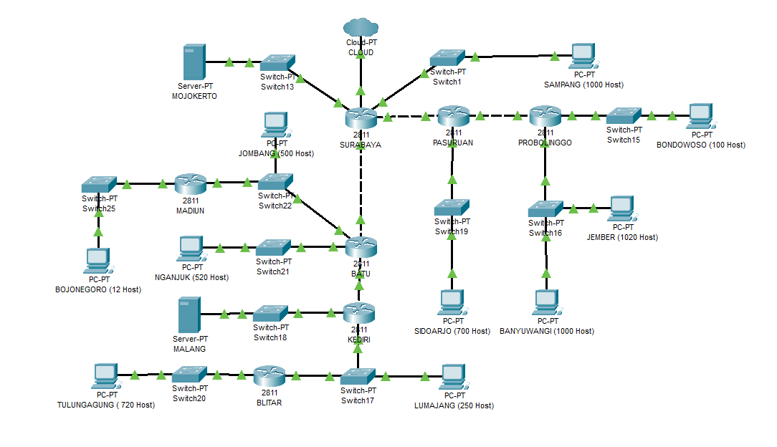
A13/22
A9/30
A12/25
A6/23
A7/30
A8/30
A5/28
A4/22
A3/30
A10/22
A11/21
A1/22
A2/24

Slide 10
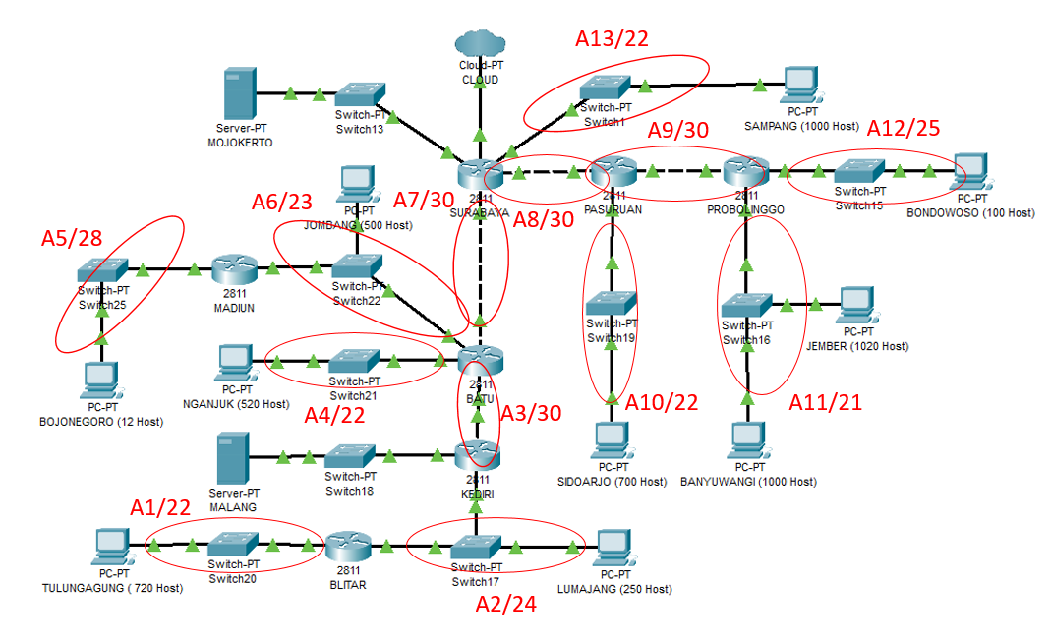
B2/22
B3/20
B1/21

Slide 11
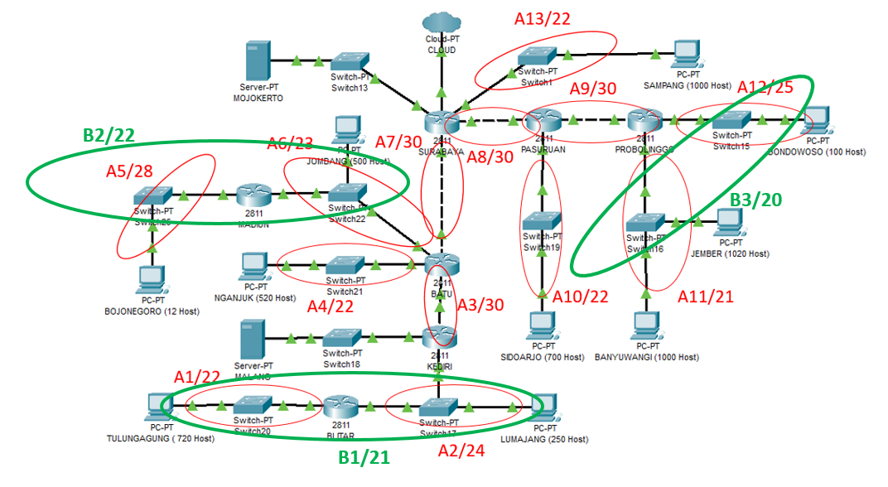
C2/21
C3/19
C1/20

Slide 12
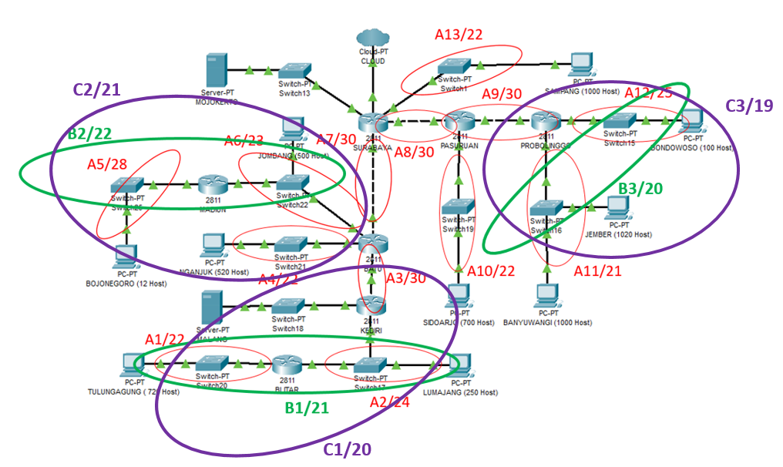
D2/18
D1/19

Slide 13
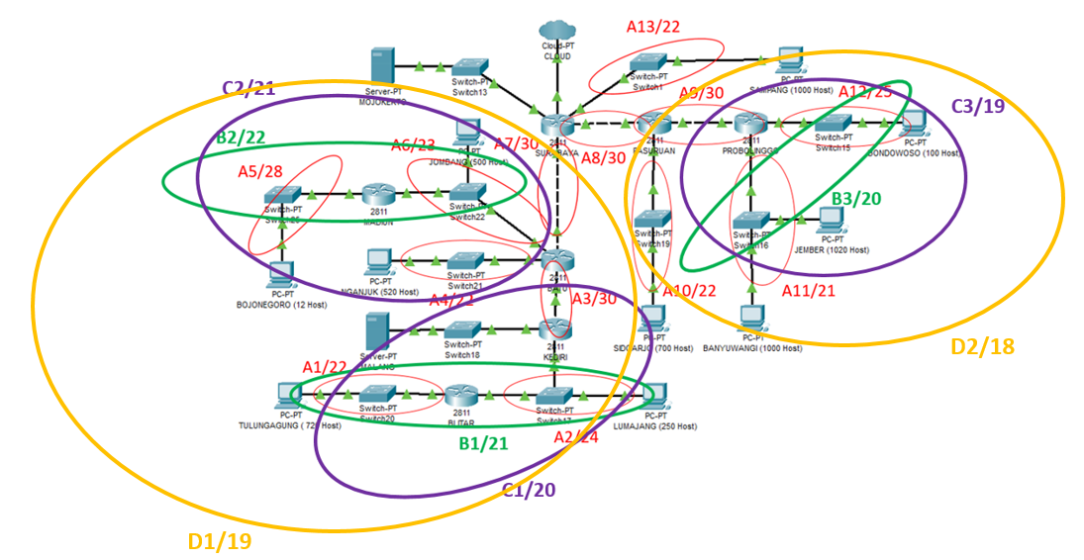
E1/17
E2/18

Slide 14
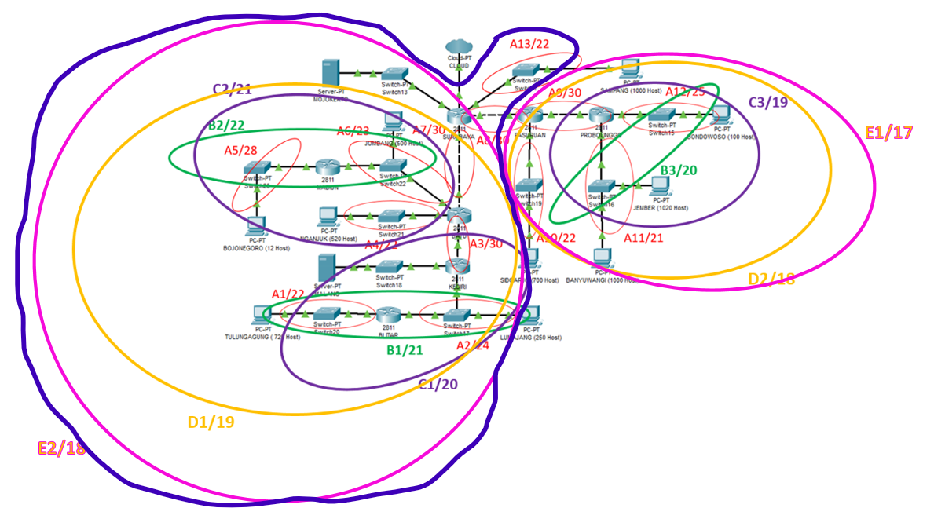
F1/17

Slide 15
G1/16
F1/17

Slide 16
NID: 192.168.0.0
Netmask: 255.255.0.0
Netmask /16
G1/16
192.168.0.0 / 16
F1/17
E1/17
192.168.0.0 / 17
192.168.128.0 / 17
A13/22
E2/18
A8/30
D2/18
192.168.64.0 / 22
192.168.0.0 / 18
192.168.192.0 / 30
192.168.128.0 / 18
D1/19
A7/30
C3/19
A10/22
192.168.0.0 / 19
192.168.32.0 / 30
192.168.128.0 / 19
192.168.160.0 / 22
C2/21
B3/20
A9/30
C1/20
192.168.128.0 / 20
192.168.144.0 / 30
192.168.0.0 / 20
192.168.16.0 / 21
A11/21
A12/25
192.168.128.0 / 21
192.168.136.0 / 25
A3/30
B1/21
192.168.8.0 / 30
192.168.0.0 / 21
B2/22
A4/22
192.168.16.0 / 22
192.168.20.0 / 22
A1/22
A2/24
A5/28
A6/23
192.168.0.0 / 22
192.168.4.0 / 24
192.168.16.0 / 28
192.168.18.0 / 23

Slide 17
Subnet | Length | NID | Netmask | Broadcast Address
A1 | /22 | 192.168.0.0 | 255.255.252.0
A2 | /24 | 192.168.4.0 | 255.255.255.0
A3 | /30 | 192.168.8.0 | 255.255.255.252
A4 | /22 | 192.168.20.0 | 255.255.252.0
A5 | /28 | 192.168.16.0 | 255.255.255.240
A6 | /23 | 192.168.18.0 | 255.255.254.0
A7 | /30 | 192.168.32.0 | 255.255.255.252
A8 | /30 | 192.168.192.0 | 255.255.255.252
A9 | /30 | 192.168.144.0 | 255.255.255.252
A10 | /22 | 192.168.160.0 | 255.255.252.0
A11 | /21 | 192.168.128.0 | 255.255.248.0
A12 | /25 | 192.168.136.0 | 255.255.255.128
A13 | /22 | 192.168.64.0 | 255.255.252.0

